Slide 1
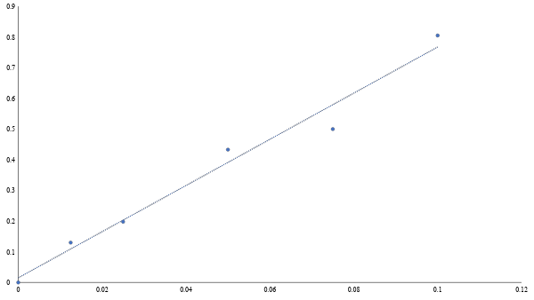
Absorbance at 325 nm
Xanthan Concentration [mg/mL]

Slide 2
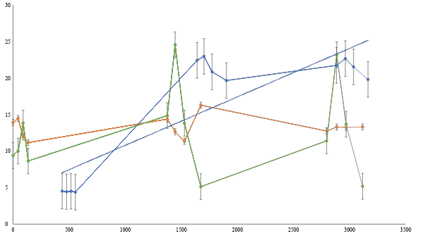
T = 25°C
Cell Density
Glucose Concentration
Concentration [mg/mL]
Cell Density at 600 nm
Xanthan Concentration
Time [min]

Slide 3
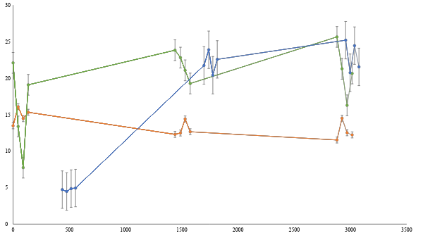
T = 30°C
Cell Density
Xanthan Concentration
Concentration [mg/mL]
Cell Density at 600 nm
Glucose Concentration
Time [min]

Slide 4
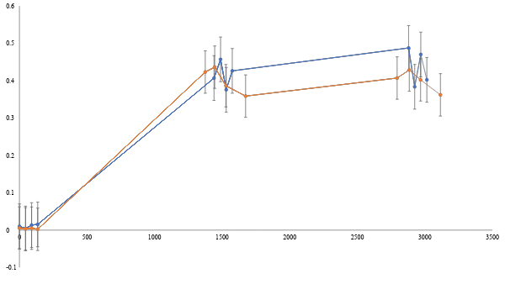
T = 30°C
T = 25°C
Cell Density at 600 nm
Time [min]

Slide 5
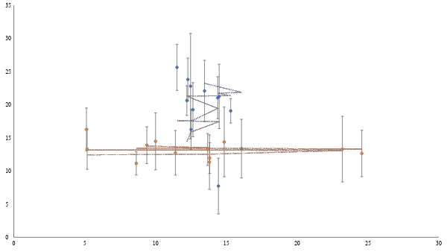
T = 25°C
Glucose Concentration [mg/mL]
T = 30°C
Xanthan Concentration [mg/mL]

